Slide 1
Scalable EMF Notification Management
Axel Uhl
© SAP AG 2010 - licensed under a Creative Commons Attribution-Noncommercial-No Derivative Works 3.0 Germany License
http://creativecommons.org/licenses/by-nc-nd/3.0/de/

Slide 2
What You Will
See in this Session
Problem Specification
Solution Approach
Performance Comparison

Slide 3
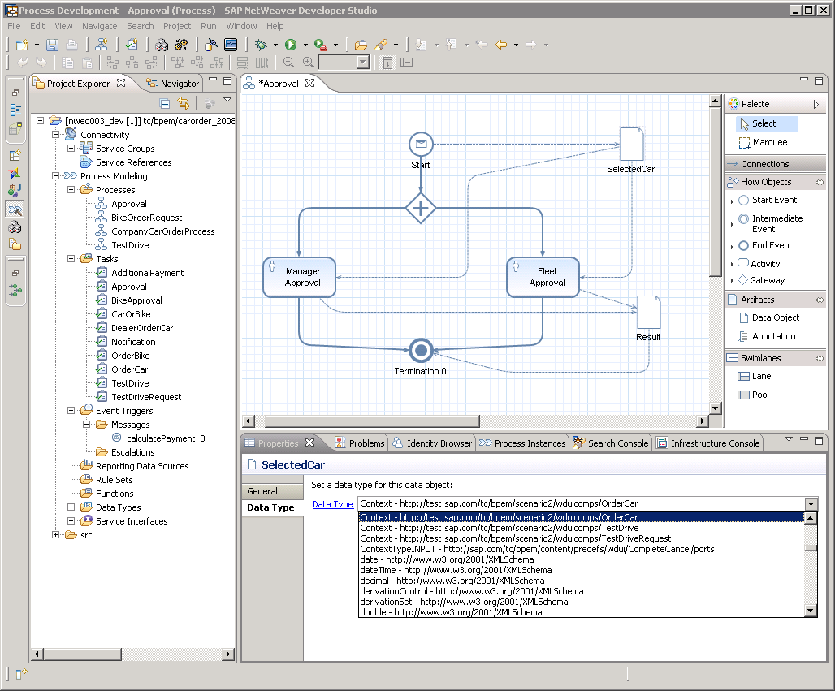
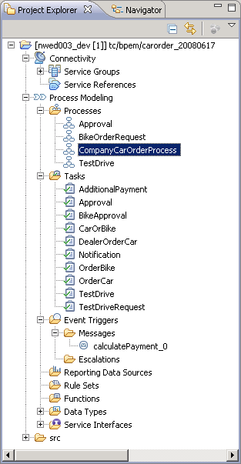
Many Adapters,
each specifying a Filter Condition,
many Notifications
Naively, all Notifications are broadcast to all Adapters. Let's look at how this scales.
Notes:
TODO: visualize occurring Notifications and many adapters with complex filter trees

Slide 4
To avoid effort for changing adapter registrations on model, use single EContentAdapter and single EventManager. Application Adapters register with EventManager.
a₁:Adapter
a_{n}:Adapter
e1:EObject
…
eAdapters
e2:EObject2
:EventManager
:EContentAdapter
e3:EObject
e4:EObject
Our benchmarks penetrate the single EContentAdapter with test Notifications
.
.
.

Slide 5
An Experiment
Register n Adapters with EventManager
Each Adapter defines a non-trivial filter condition, e.g.,
(isContainment AND ((oldValue class conformsTo ABC)
OR (newValue class conformsTo ABC)))
OR ((notifier class conformsTo ABC) AND (feature is ABC.name))
Fire seven different Notifications, each 1000 times
Measure two numbers:
time it takes to deliver Notifications to Adapters
number of Adapters notified ("Delivered")
Example measurement for
firing 1000 SET Notifications
for an EAttribute
Number of Adapters (n)
Notes:
Note the approximately and expected linear increase as the number of adapters increases

Slide 6
What's so bad about it is this:
Even if no adapter is interested in the change, we pay.
And we pay per Adapter.

Slide 7
Here go all benchmark results for our seven different notifications with naïve approach:
Time increases at least linearly with
growing number of Adapters, even if
few or no Notifications are delivered

Slide 8
Wouldn't it be cool if filter conditions got centrally managed,
and Notifications got centrally dispatched? Maybe then we could improve performance, particularly by not bothering those Adapters not interested in a Notification…

Slide 9
Key idea:
Use hash maps
to map Notification fields to Set<Adapter>
notifier.eClass() conforms to | Set<Adapter> interested
Parameter | [a1, a7, a15]
Method | [a1, a3, a9]
… | …
Notification:
- notifier
- oldValue
- newValue
- feature
- eventType
…
…
feature | Set<Adapter> interested
NamedElement.name | [a3, a9, a14]
MethodCall.source | [a7, a15]
… | …

Slide 10
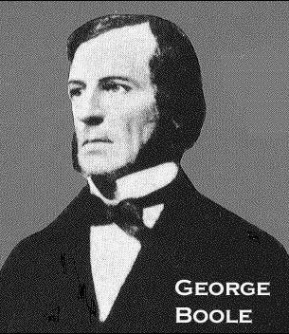
But filter conditions can be Boolean
expressions over elementary predicates
AND
AND
OR
oldValue class conformsTo DEF
NOT
notifier class conformsTo ABC
newValue class conformsTo DEF
feature is ABC.d
Compute Disjunctive Normal Form (DNF)
(a ∧ b ∧ ¬c ∧ d) ∨ (e ∧ f) ∨ (g ∧ h ∧ ¬ i)

Slide 11
Filter for Adapter a_{i} in DNF
(a ∧ b ∧ ¬c ∧ d) ∨ (e ∧ f) ∨ (g ∧ h ∧ ¬ i)
Registrations
r_{1,ai}
r_{2,ai}
r_{3,ai}
Each Registration spreads across one or more tables.
Negated entries may occur, requiring a separate column.
Each Registration knows in which tables it occurs.
notifier class conformsTo | Set<Adapter> requiring | Set<Adapter> requiring NOT
Parameter | [r_{1,a1}, r_{1,a7}, r_{1,a15}]
Method | [r_{2,a1}, r_{1,a3}, r_{1,a9}] | [r_{1,a4}, r_{1,a8}]
… | …
…
feature is | Set<Adapter> requiring | Set<Adapter> requiring NOT
NamedElement.name | [r_{1,a3}, r_{1,a9}, r_{1,a14}] | [r_{1,a7}]
MethodCall.source | [r_{2,a7}, r_{2,a15}]
… | …

Slide 12
Mapping Notification to Adapters:
for each table, extract criterion from Notification
look up requiring/requiring-NOT sets for criterion
for each combination c of tables in which registrations occur:
for each table t in combination c:
u_{t} := ((r∈requiring set for criterion with r in c) ∪ (r∈all requiring-NOT sets with r in c)) \ (requiring-NOT set for criterion)
i_{c} := ∩u_{t} over all tables t in current combination c
regs := ∪i_{c} over all combinations c in which registrations occur
map registrations in regs to their respective adapter
_{t}
_{c}
notifier class conformsTo | Set<Adapter> requiring | Set<Adapter> requiring NOT
Parameter | [r_{1,a1}, r_{1,a7}, r_{1,a15}]
Method | [r_{2,a1}, r_{1,a3}, r_{1,a9}] | [r_{1,a4}, r_{1,a8}]
… | …

Slide 13
Example using Ecore
Adapter a₁: notifier class conformsTo EOperation AND
feature is EOperation.eParameters
Adapter a₂: notifier class conformsTo EClass AND
feature is ENamedElement.name
Adapter a₃: notifier class conformsTo EPackage AND
feature is EPackage.eClassifiers AND
NOT newValue class conformsTo EDataType
Adapter a₄: notifier class conformsTo EClass AND
feature is EClass.abstract
Well… luckily the filter expressions are already in DNF,
and each expression leads to only one registration :-)

Slide 14
Resulting Tables
Adapter a₁: notifier class conformsTo EOperation AND
feature is EOperation.eParameters
Adapter a₂: notifier class conformsTo EClass AND
feature is ENamedElement.name
Adapter a₃: notifier class conformsTo EPackage AND
feature is EPackage.eClassifiers AND
NOT newValue class conformsTo EDataType
Adapter a₄: notifier class conformsTo EClass AND
feature is EClass.abstract
notifier class conformsTo | Set<Adapter> requiring | Set<Adapter> requiring NOT
EOperation | [r_{a1}]
EClass | [r_{a2}, r_{a4}]
EPackage | [r_{a3}]
newValue class conformsTo | Set<Adapter> requiring | Set<Adapter> requiring NOT
EDataType |  | [r_{a3}]
feature is | Set<Adapter> requiring | Set<Adapter> requiring NOT
EOperation.eParameters | [r_{a1}]
ENamedElement.name | [r_{a2}]
EPackage.eClassifiers | [r_{a3}]
EClass.abstract | [r_{a4}]

Slide 15
Resulting Tables
Adapter a₁: notifier class conformsTo EOperation AND
feature is EOperation.eParameters
Adapter a₂: notifier class conformsTo EClass AND
feature is ENamedElement.name
Adapter a₃: notifier class conformsTo EPackage AND
feature is EPackage.eClassifiers AND
NOT newValue class conformsTo EDataType
Adapter a₄: notifier class conformsTo EClass AND
feature is EClass.abstract
notifier class conformsTo | Set<Adapter> requiring | Set<Adapter> requiring NOT
EOperation | [r_{a1}]
EClass | [r_{a2}, r_{a4}]
EPackage | [r_{a3}]
newValue class conformsTo | Set<Adapter> requiring | Set<Adapter> requiring NOT
EDataType |  | [r_{a3}]
feature is | Set<Adapter> requiring | Set<Adapter> requiring NOT
EOperation.eParameters | [r_{a1}]
ENamedElement.name | [r_{a2}]
EPackage.eClassifiers | [r_{a3}]
EClass.abstract | [r_{a4}]

Slide 16
Handling Notifications
notifier class conformsTo | Set<Adapter> requiring | Set<Adapter> requiring NOT
EOperation | [r_{a1}]
EClass | [r_{a2}, r_{a4}]
EPackage | [r_{a3}]
newValue class conformsTo | Set<Adapter> requiring | Set<Adapter> requiring NOT
EDataType |  | [r_{a3}]
feature is | Set<Adapter> requiring | Set<Adapter> requiring NOT
EOperation.eParameters | [r_{a1}]
ENamedElement.name | [r_{a2}]
EPackage.eClassifiers | [r_{a3}]
EClass.abstract | [r_{a4}]
Notification: notifier class EOperation, feature is eParameters
Table combination: "notifier class conformsTo", "feature is"
(([r_{a1}] ∪∅) \ ∅) ∩ (([r_{a1}] ∪∅) \ ∅) = [r_{a1}] ∩ [r_{a1}] = [r_{a1}]

Slide 17
Handling Notifications
notifier class conformsTo | Set<Adapter> requiring | Set<Adapter> requiring NOT
EOperation | [r_{a1}]
EClass | [r_{a2}, r_{a4}]
EPackage | [r_{a3}]
newValue class conformsTo | Set<Adapter> requiring | Set<Adapter> requiring NOT
EDataType |  | [r_{a3}]
feature is | Set<Adapter> requiring | Set<Adapter> requiring NOT
EOperation.eParameters | [r_{a1}]
ENamedElement.name | [r_{a2}]
EPackage.eClassifiers | [r_{a3}]
EClass.abstract | [r_{a4}]
Notification: notifier class EPackage, feature is EPackage.eClassifiers, newValue class EClass
Table combination: "notifier class conformsTo", "newValue class conformsTo", "feature is"
(([r_{a3}] ∪∅) \ ∅) ∩ ((∅∪[r_{a3}]) \ ∅) ∩ (([r_{a3}] ∪∅) \ ∅) = [r_{a3}] ∩ [r_{a3}] ∩ [r_{a3}] = [r_{a3}]

Slide 18
Handling Notifications
notifier class conformsTo | Set<Adapter> requiring | Set<Adapter> requiring NOT
EOperation | [r_{a1}]
EClass | [r_{a2}, r_{a4}]
EPackage | [r_{a3}]
newValue class conformsTo | Set<Adapter> requiring | Set<Adapter> requiring NOT
EDataType |  | [r_{a3}]
feature is | Set<Adapter> requiring | Set<Adapter> requiring NOT
EOperation.eParameters | [r_{a1}]
ENamedElement.name | [r_{a2}]
EPackage.eClassifiers | [r_{a3}]
EClass.abstract | [r_{a4}]
Notification: notifier class EPackage, feature is EPackage.eClassifiers, newValue class EDataType
Table combination: "notifier class conformsTo", "newValue class conformsTo", "feature is"
(([r_{a3}] ∪∅) \ ∅) ∩ ((∅∪[r_{a3}]) \ [r_{a3}]) ∩ (([r_{a3}] ∪∅) \ ∅) = [r_{a3}] ∩ ∅ ∩ [r_{a3}] = ∅

Slide 19
Let's compare. Here go the benchmarks for the same Notifications/Adapters:
No time increase anymore for Adapters
whose filters don't match a Notification;
much faster delivery for those that do.

Slide 20
The API
EventManagerFactory
public interface EventManagerFactory {
EventManagerFactory eINSTANCE = …;
EventManager getEventManagerFor(ResourceSet set);
EventManager createEventManager();
EventManager createEventManagerFor(ResourceSet set);
EventFilter create…Filter(…);
}
Notes:
Query for model changes
Scope: Elements loaded by the Diagram

Slide 21
The API
EventManager
public interface EventManager {
void subscribe(EventFilter filter, Adapter listener);
boolean unsubscribe(Adapter listener);
void addToObservedResourceSets(ResourceSet resourceSet);
void removeFromObservedResourceSets(ResourceSet resourceSet);
void setActive(boolean active);
}
Notes:
Query for model changes
Scope: Elements loaded by the Diagram

Slide 22
Where to find it?
Indigo Update Site:
Install “OCL Examples and Editors” feature from the “Modeling” category
CVS:
:pserver:anonymous@dev.eclipse.org/cvsroot/modeling/org.eclipse.mdt/↵
org.eclipse.ocl/examples/org.eclipse.ocl.examples.eventmanager
Download recent builds:
http://www.eclipse.org/modeling/mdt/downloads/?project=ocl

Slide 23
What‘s next?
Ships in MDT/OCL Examples with Indigo
Further improve performance and test base
e.g., using specialized content adapter only attaching where needed
Hope to transition to EMF Core after Indigo

Slide 24
give
Please
it a try
us
feedback

Slide 25
Questions
axel DOT uhl AT SAP DOT COM

